Slide 2
Welcome
Each person is a beloved member of our church family.

Slide 3
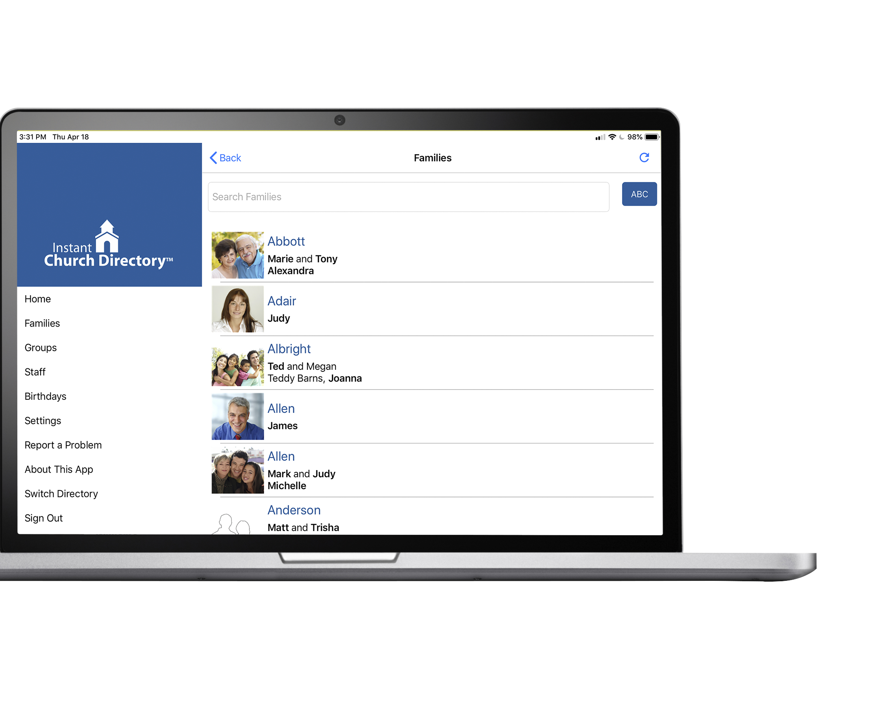
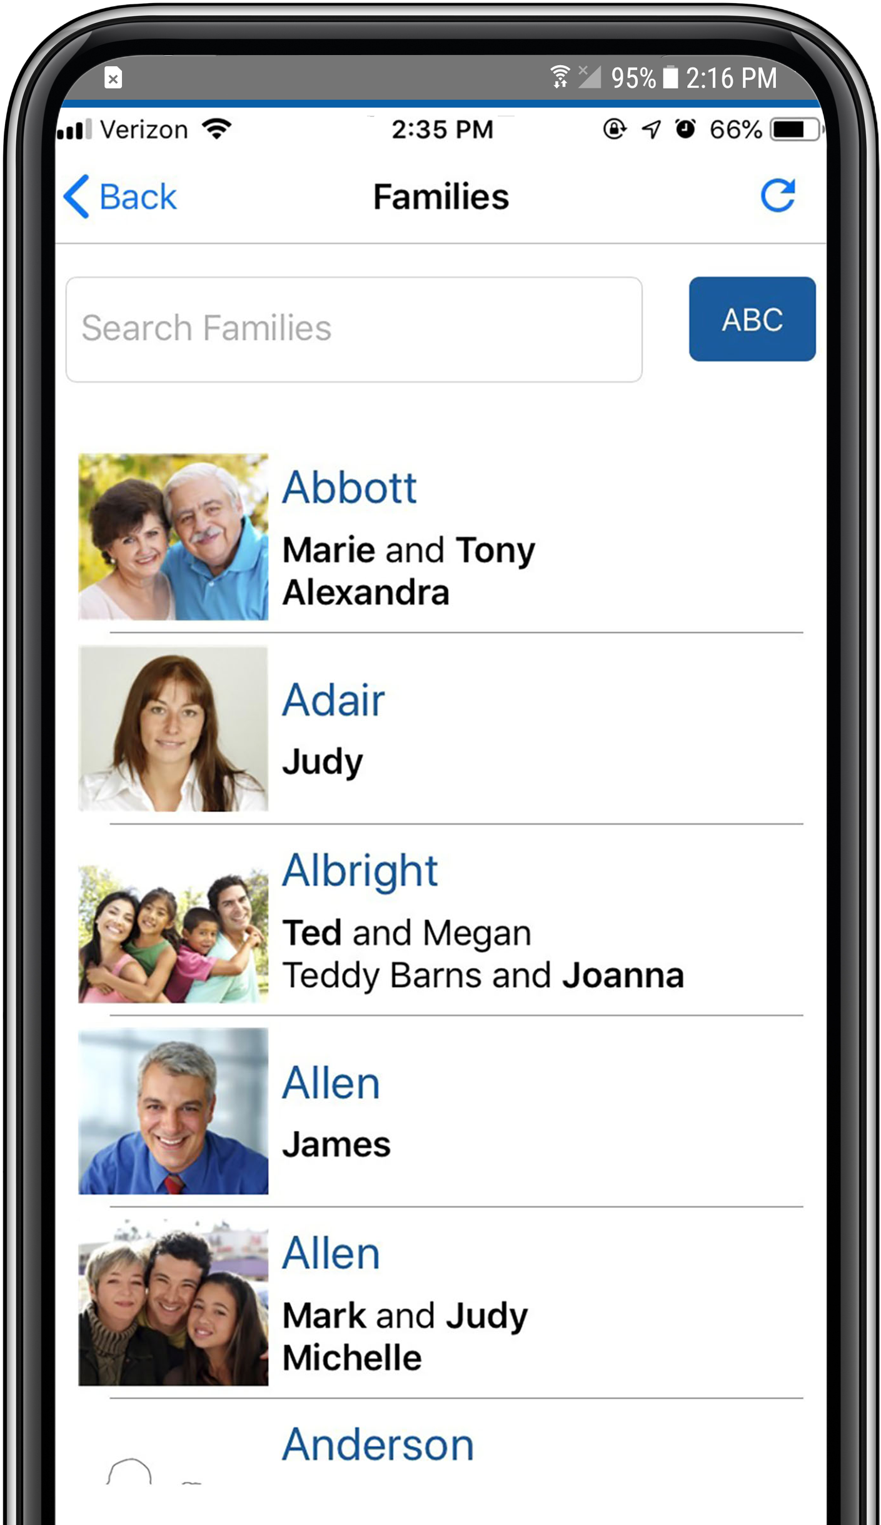
Our online directory and mobile apps
can help us call each other by name.

Slide 4
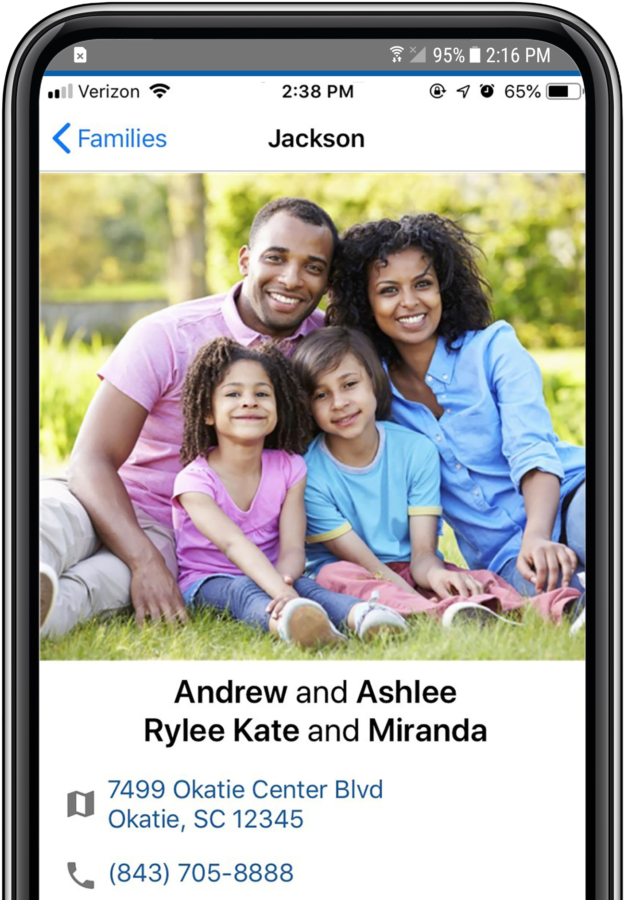
Did you know you can ...
Did you know you can ...
View Families in our directory
Search for Members by
First or Last Name
Search for Members

Slide 5
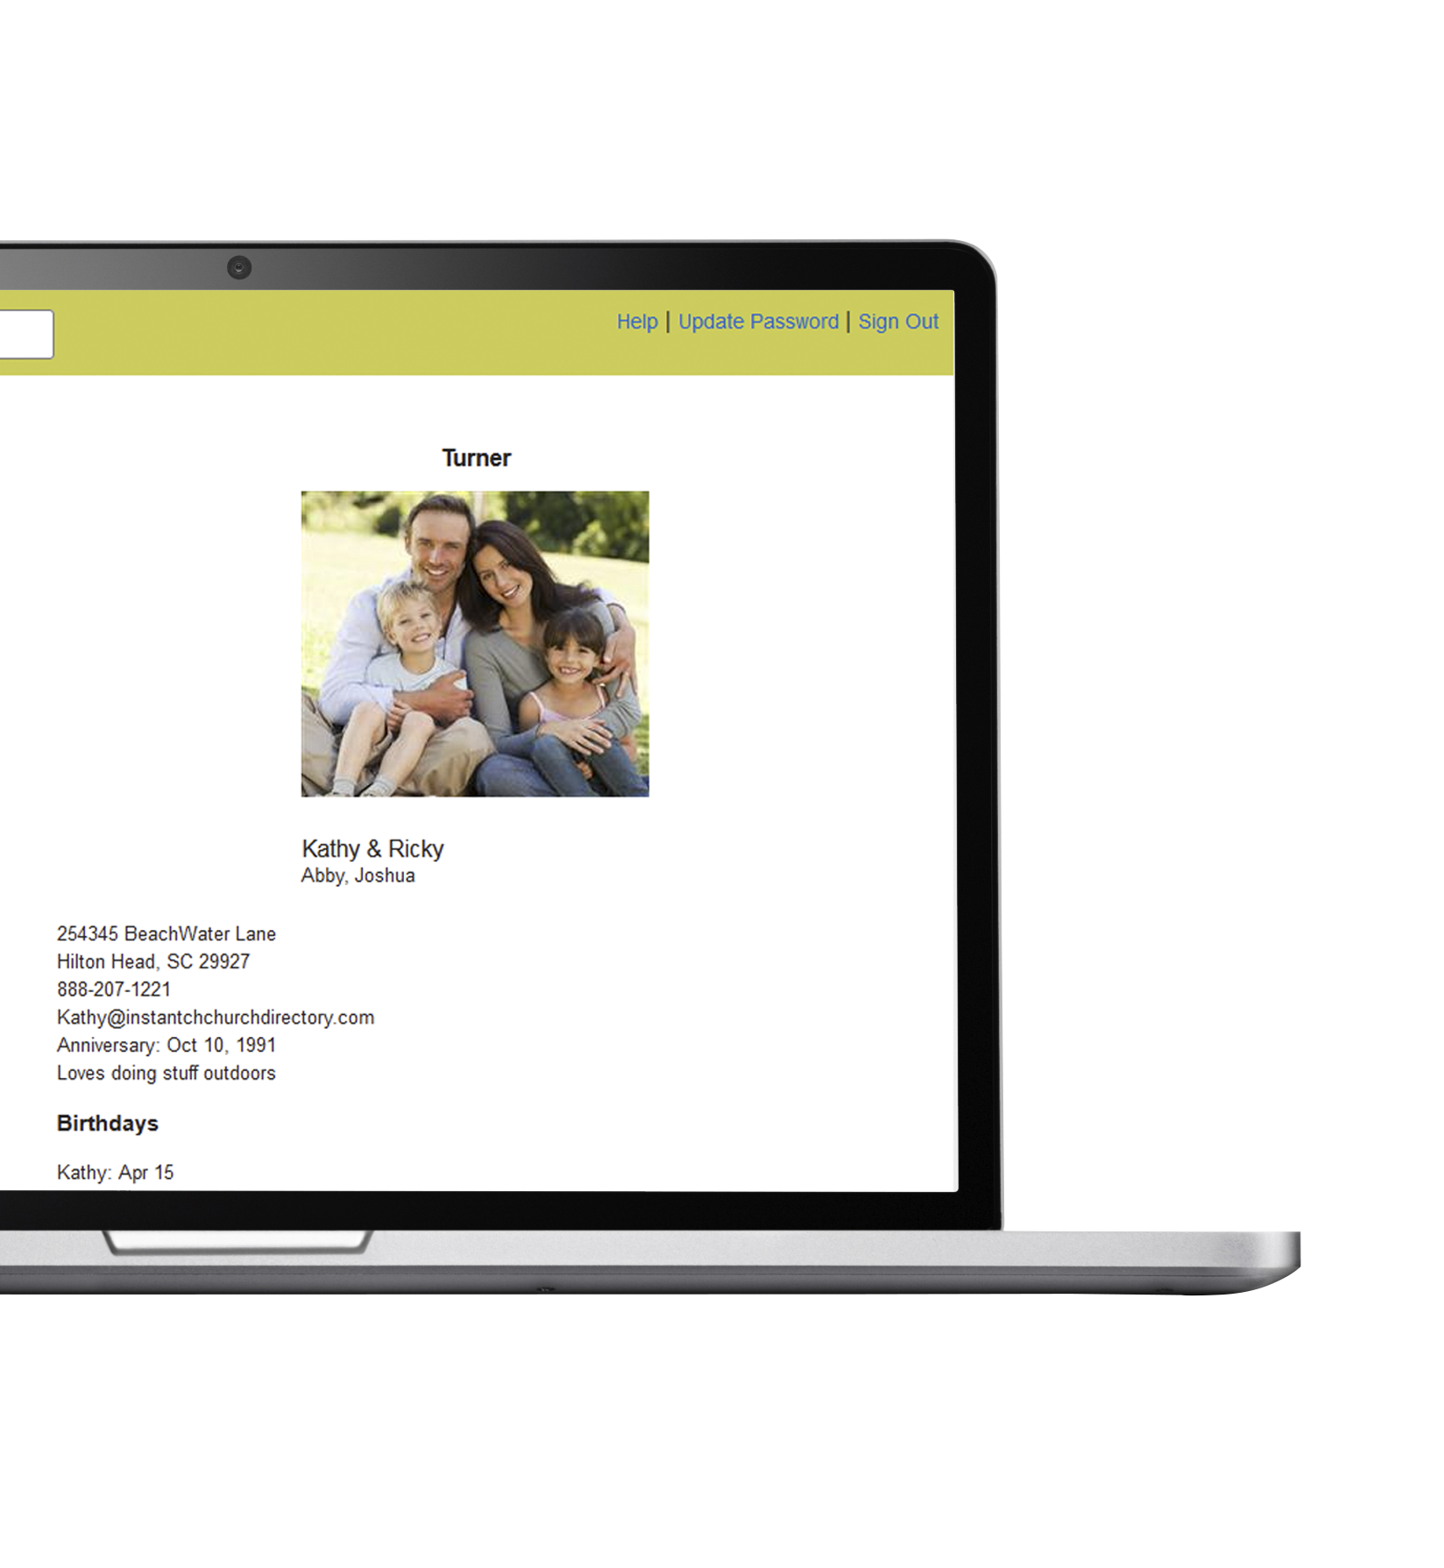
Hold down on a phone number to text or call another member
Touch an address to locate it on a map
Touch or click an email to send an email

Slide 7
Download the FREE mobile app today!

Slide 8
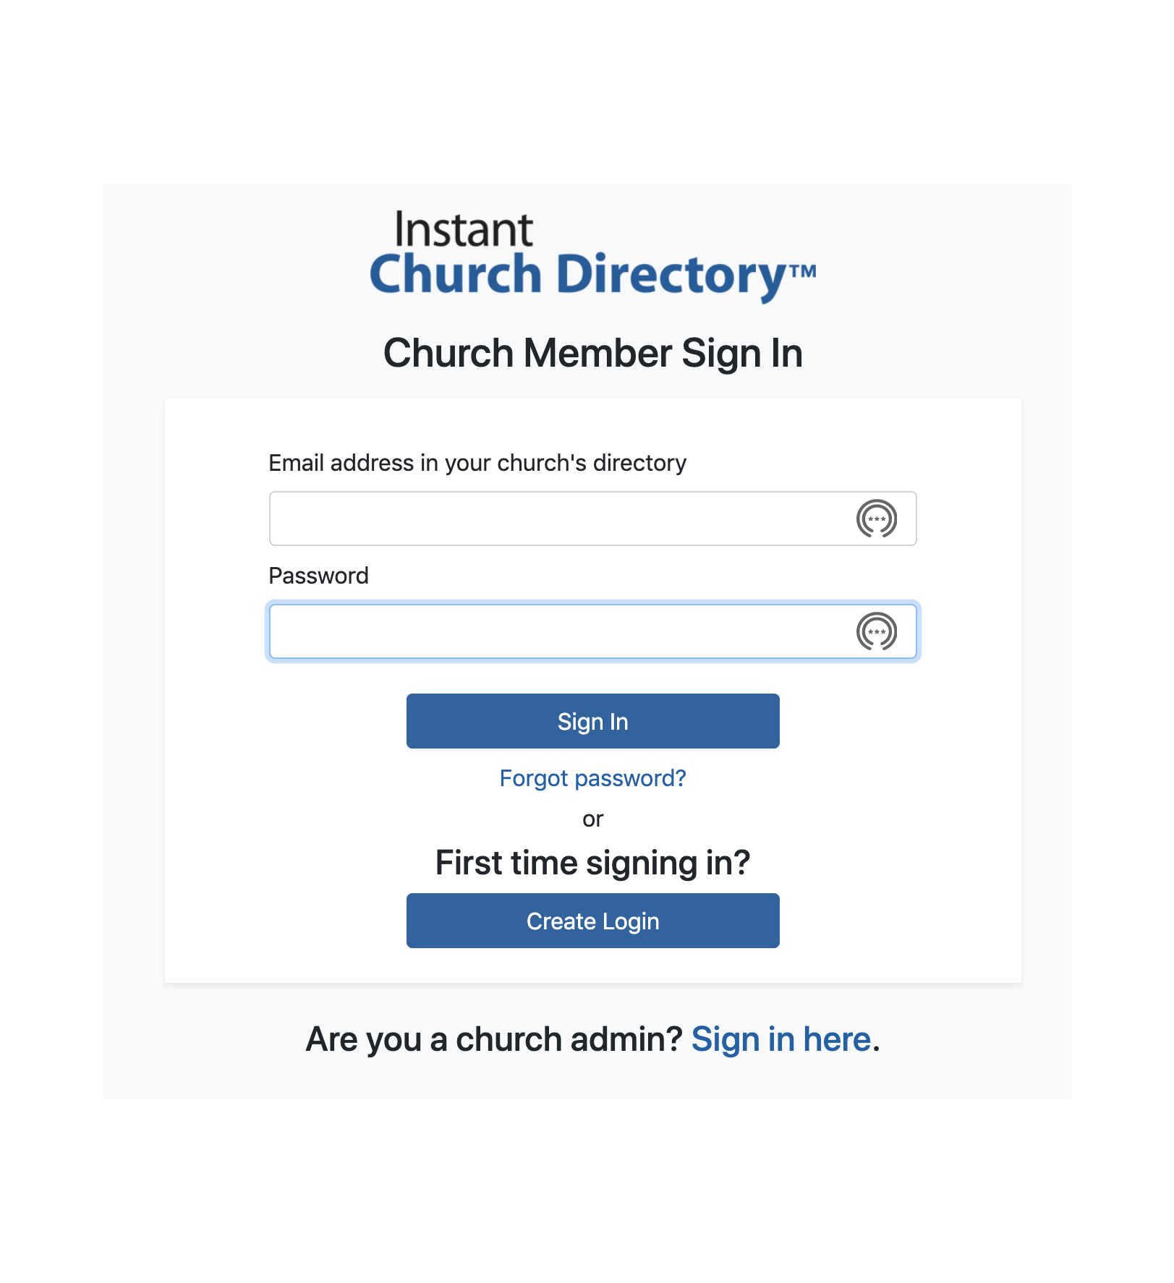
Or view online at members.InstantChurchDirectory.com
members.InstantChurchDirectory.com

Slide 9
members.InstantChurchDirectory.com
Create a login with your email listed in the directory and a password of YOUR choice.

Slide 10
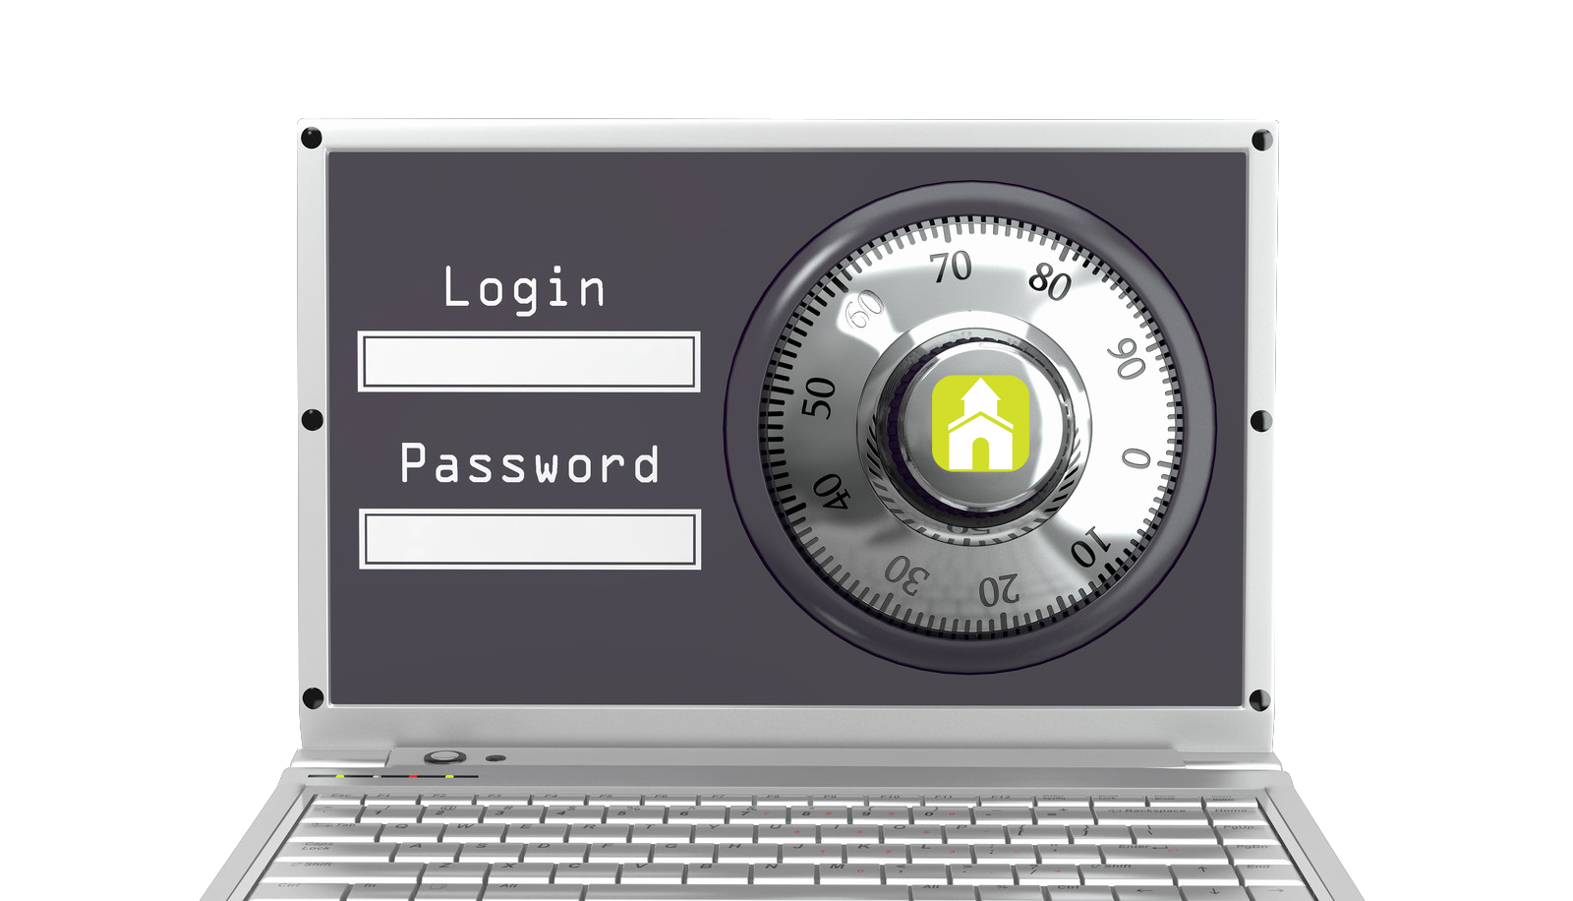
Our directory is ONLY available to members of our church, so be sure you’re in our directory before you begin!

Slide 11
?
Questions
Contact our directory administrator, [Admin Name].

